Slide 1
Streaming Data Analysis.
And its Key Insights & Trends

Slide 2
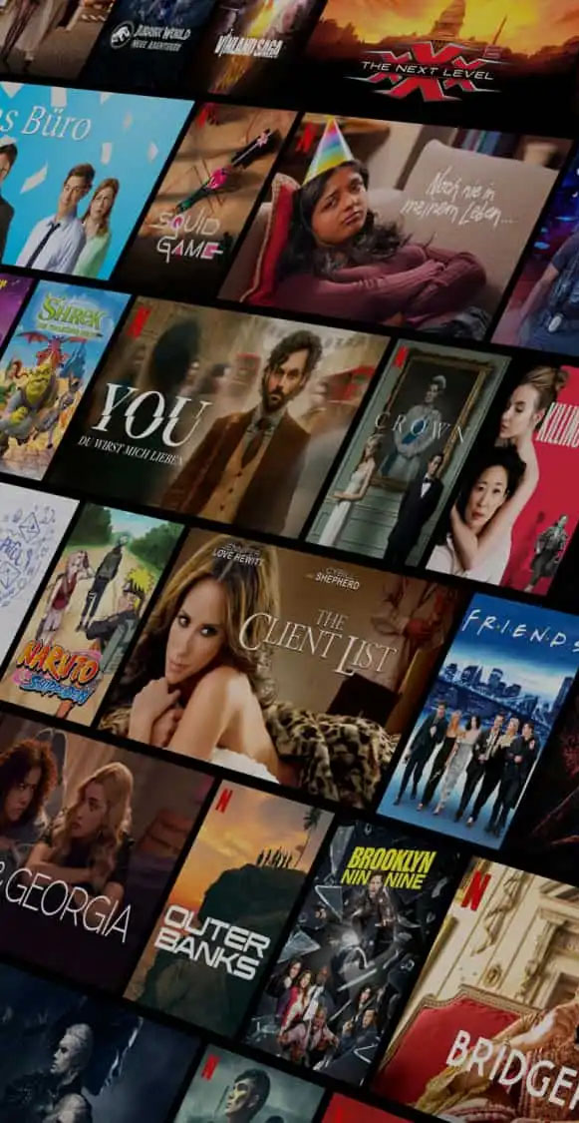
Introduction:
This presentation provides insights into user behavior, covering revenue trends, user engagement, content preferences, and regional trends for better experience and business decisions.
Data Source: Streaming Service Data.
Using Excel and PowerPoint.

Slide 3
Key Analysis Areas
Subscription & Revenue Analysis.
User Engagement Metrics.
Demographic & Behavioral Insights.
Retention & Loyalty.
Payment Preferences & Regional Trends.

Slide 4
Subscription & Revenue Insights.
Monthly revenue based on different
subscription plans.
User distribution across different price tiers.

Slide 5
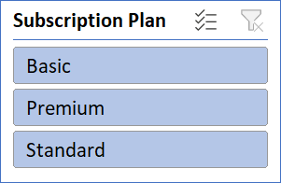
Revenue Analysis On Subscription Plan

Slide 6
Monthly Revenue by Subscription. Basic - 2580.77 Premium - 5308.68 Standard - 4136.55 Grand Total - 12026 After analyzing the revenue by subscription plan, people chose the “PREMIUM” plan the most.

Slide 7
Distribution OF users Across Price Tiers

Slide 8
User distribution across different price tiers. Basic - 323 Users Premium - 332 Users Standard - 345 Users
Majority of users prefer mid-tier plans, with a smaller percentage opting for premium subscriptions.

Slide 9
2. USER ENGAGEMENT METRICS
Average watch hours per user
Movies vs. Series watched per user
Impact of recommended content on
engagement

Slide 10
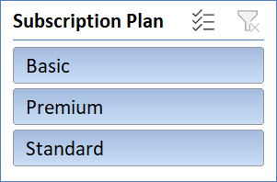
Average watch hours per user

Slide 11
Average watch hour per user
Basic - 323 Users , 1141 Watcher , 254.49 Average
watch time per user
Standard - 345 Users , 1190 Watcher , 257.08 Average
watch time per user
Premium - 332 Users , 1129 Watcher , 251.86 Average
watch time per user
Users spend an average of hours streaming per month, with peak engagement during weekends.

Slide 12
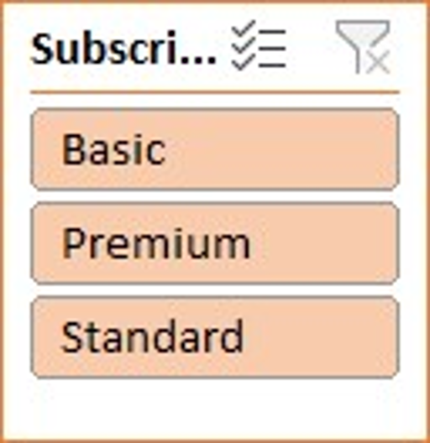
Movies vs. Series Watched Per User

Slide 13
Total Series VS Movie watch
Total Series watch - 99746 Hours
Total Movie watch - 515897 Hours
Movies are watched more frequently than series, though binge-watching trends indicate strong series engagement.

Slide 14
Impact of Recommended Content on Engagement

Slide 15
Impact of recommended content on engagement.
The sum of watch hours - 254516
The sum of engagement percentage from recommendation - 43790.01
Recommended content significantly influences engagement, with a high percentage of users consuming suggested content.

Slide 16
3. Demographic & Behavioral Insights:
Preferred genres by age group
Device usage trends
Peak watch time trends

Slide 17
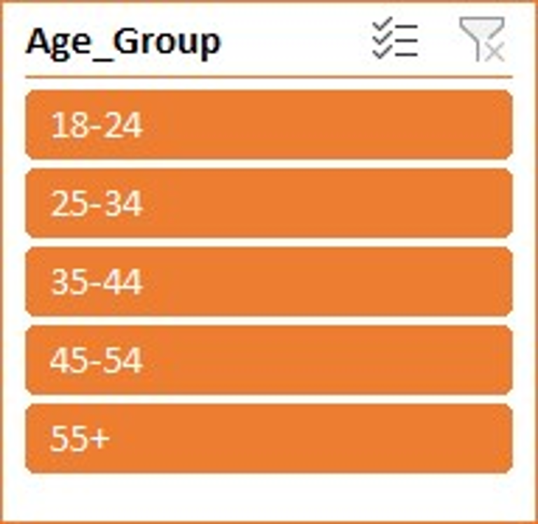
Preferred Genres by Age Group

Slide 18
Preferred genres by age groups
Age Group 18 – 25 is more preferring “Documentary”.
Age Group 25 - 34 is more preferring “Horror”.
Age Group 34 - 44 is more preferring “Horror”.
Age Group 45 - 54 is more preferring “Romance”.
Age Group 55 + is more preferring “Comedy”.
Different age groups prefer distinct genres; younger audiences favor action & adventure, while older users prefer comedy drama.

Slide 19
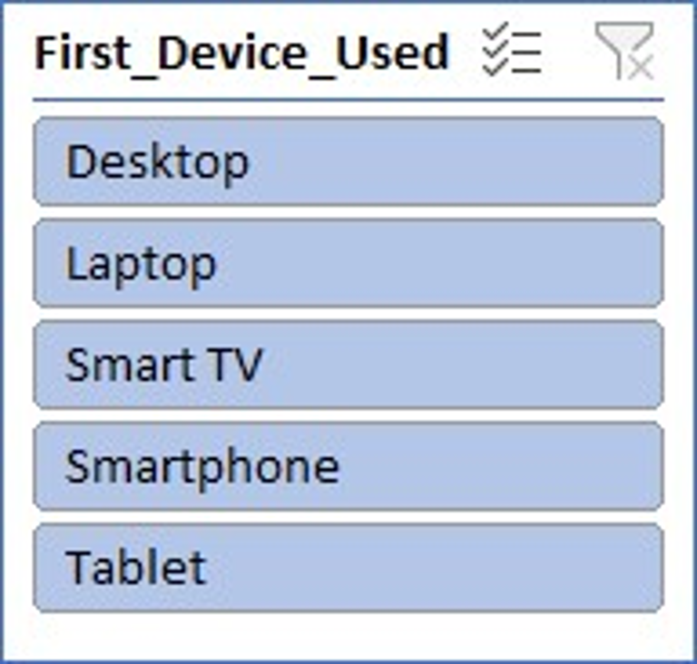
Device Usage Trends

Slide 20
Device usage trends
“Desktop” is used by 45-54 age group.
“Laptop” and “Tablet” are used by 25-34 age group.
“Smart TV” is used by 55+ age group.
“Smart Phone” is used by 35-44 age group.
And the youngster group of 18-24 age are mostly used “Tablet”.
Mobile devices dominate streaming, but Smart TVs see increased engagement for longer sessions.

Slide 21
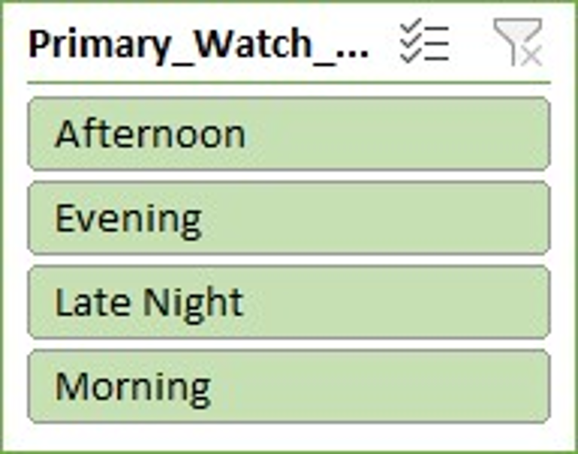
Peak Watch Time Trends

Slide 22
Peak watch time trends (Morning, Afternoon,
Evening, Late night)
Total watch hour in Afternoon period is “62017 Hours”.
Total watch hour in Evening period is “65381 Hours”.
Total watch hour in Late Night period is “66661 Hours”.
Total watch hour in Morning period is “60457 Hours”.
Evening hours (7-11 PM) are peak streaming times, with late-night viewing increasing among younger users.

Slide 23
4. Retention & Loyalty :
Members Status(Active vs. inactive)
Loyalty points distribution
Frequency of logins and downloads

Slide 24
Members Status (Active vs. inactive)

Slide 25
Membership Status (Active VS
Inactive)
There are total of “1000 Users” are active and no
users are found inactive.

Slide 26
Loyalty Points Distribution
SHOWING LOYALTY POINTS DISTRIBUTION
BY VARIOUS WAY.
1. Loyalty Points by Subscription Plans
2. Loyalty Points by Engagement Level
3. Loyalty Points Distribution by all Users

Slide 27
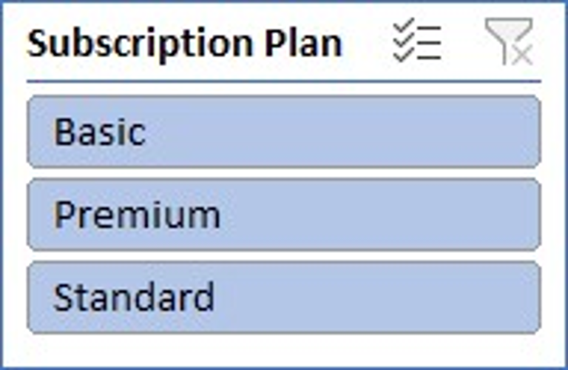
1. Loyalty Points by Subscription Plans

Slide 28
2. Loyalty Points by Engagement Level

Slide 29
3. Loyalty Points Distribution by all Users

Slide 30
Loyalty points distribution
Among all of the “1000 Users” Averagely 2444.21 are
distributed in there loyalty points .
Higher loyalty points correlate with longer subscription durations and higher engagement.

Slide 31
Login Frequency & Content Downloads

Slide 32
Frequency of login and content downloads
There are above months 29 - November has the highest number of download.
Frequent logins indicate highly engaged users, with a positive correlation to content downloads.

Slide 33
4. Payment Preferences & Regional Trends :
Preferred payment methods by region
Subscription trends by country
Language preferences and engagement

Slide 34
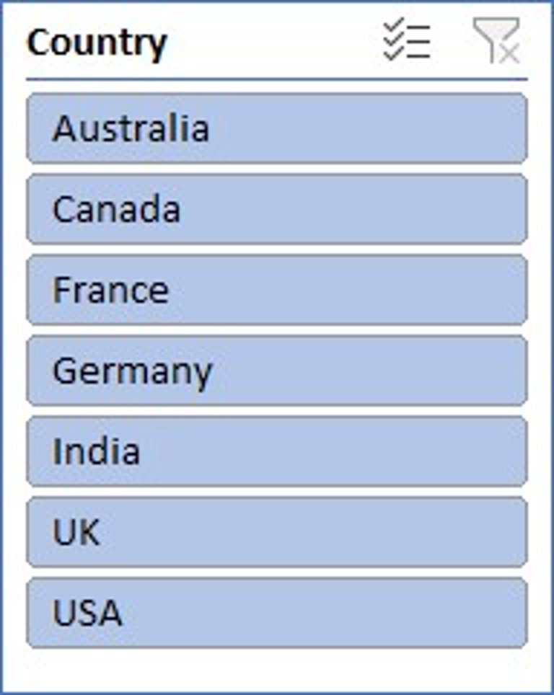
Payment Preferences by Region

Slide 35
Preferred payment method by region
In AUSTRALIA users use the payment method most of “CRYPTOCURRENCY”.
In CANADA users use the payment method most of “PAYPAL”.
In FRANCE users use the payment method most of “CRYPTOCURRENCY”.
In GERMANY users use the payment method most of is “DEBIT CARD”.
In INDIA users use the payment method most of “DEBIT CARD”.
In UK users use the payment method most of “PAY PAL”.
In USA users use the payment method most of “CREDIT CARD”.
Credit cards are the dominant payment method, but digital wallets are gaining popularity in certain regions.

Slide 36
Subscription Trends by Country

Slide 37
In AUSTRILIA the most preferable subscription plan is “PREMIUM”.
In CANADA the most preferable subscription plan is “PREMIUM”.
In FRANCE the most preferable subscription plan is “BASIC”.
In GERMANY the most preferable subscription plan is “STANDARD”.
In INDIA the most preferable subscription plan is “STANDARD”.
In UK the most preferable subscription plan is “STANDARD”.
In USA the most preferable subscription plan is equal between “BASIC and STANDARD”.
Regional preferences impact subscription choices, with country-specific pricing affecting adoption rates.

Slide 38
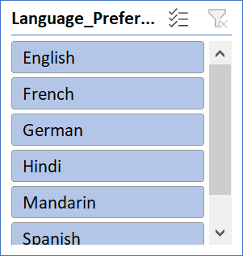
Language Preferences & Engagement
Users prefer content in their native languages, with subtitles playing a key role in engagement.

Slide 39
Conclusion & Recommendations
• Subscription trends indicate shifts in user preferences.
• Engagement varies based on content type and recommendations.
• Regional payment preferences influence revenue strategies.
• Retention efforts can be improved through personalized experiences.
Further actions can be taken based on these insights to enhance user satisfaction.

Slide 40
Thank You!

